Slide 1

ULTRASONIC SENSORED SPECTACLES FOR BLIND
Department of Information Technology
Submitted By:
Balasubramaniyam S (U22IT006)
Mohammed sitthik A (U22IT026)
Tharuneeshwaran A S (U22IT049)
Guided By:
Dr.R.Yogesh Rajkumar
Assistant Professor
Department of Information Technology
BIHER.

Slide 2

CONTENTS
Abstract
Introduction
Applications
Literature Survey
Motivation
Objective
Proposed Work
Implementation
Results and Discussion
Conclusion
Future Work
Publication
References

Slide 3
INTRODUCTION
Blind people are usually dependent on assistance from others. The assistance can be from human beings, dogs or some special electronic devices. There are already many existing devices which help a blind person in walking. The most common is the simple walking stick or cane. The blind man uses it to detect the obstacles by sweeping the cane back and forth but unfortunately sometimes the blind man gets aware about the obstacle too late. With the recent advances in technology normal walking can has been modified to a blind glasses with an ultrasonic sensor attached to it. It has several limitations. Therefore, the solution that has been portrayed is cost effective, reliable, robust and portable device which would help a blind person to walk on the streets almost like any other pedestrian.
This project aims to design and develop a lightweight, affordable, and wearable device that can enhance the confidence and mobility of visually impaired individuals, making everyday navigation more convenient and secure.

Slide 4
APPLICATIONS
The Ultrasonic Sensor–Based Spectacles have a wide range of practical applications, especially aimed at improving the quality of life for visually impaired individuals.
Assistance for Visually Impaired People
Helps visually challenged users detect obstacles and navigate safely in unfamiliar environments.
Indoor and Outdoor Navigation
Useful for safe movement in homes, offices, schools, and public spaces.
Smart Wearable Technology
Forms a foundation for future smart assistive wearables that combine sensors, AI, and IoT for advanced mobility support.
Obstacle Detection in Robotics
The same ultrasonic sensing principle can be applied in autonomous robots, wheelchairs, and guidance systems for obstacle detection and path planning.

Slide 5
MOTIVATION
The main motivation is to assist visually impaired individuals in navigating safely and independently.
By using ultrasonic sensors with Arduino Nano, obstacles can be detected effectively in real time.
This project aims to provide a low-cost, portable, and reliable smart aid for the blind. It reflects a step toward using technology for social welfare and human assistance.

Slide 6

Review of Literature
S.NO | Author | Title | Topic | Inference
1. | Siddharth Swami, Rajesh Singh, Saurabh Dhyani, Garima Rathi, Sanjeev Kumar Shah, Manish Ghalwan, Nagendar Yamsani [2025] | An Affordable Low-Cost Wearable Solution for Object Detection in Visual Impairment. | The paper focuses on assistive technology for visually impaired individuals, specifically developing a low-cost wearable device that helps detect nearby obstacles. | The wearable device successfully detects obstacles in real time and alerts the user through a buzzer sound.
2. | Vaishnavi Lingawar, Madhunika Nilakhe, Mrunali Kamble, and Prof. M.P. Shinde [2023] | Ultrasonic Smart Glasses for Visually Impaired Peoples. | The study states, a device integrates an ultrasonic sensor, processing unit (Arduino Uno), buzzer, and MP3 output to help users navigate safely and independently. | The study concludes that ultrasonic smart glasses can function as a “third eye” for visually impaired Individual.
3. | Kaushalya Thopate, Ketki Shirbavikar, Radhika V. Kulkarni, Rajesh Phursule, Vaibhav Kale, Suyash Karjule, Kamlait Suhas, Suparshva Kale [2024] | Enhancing Ultrasonic Sensor Goggles for Blinds Using Node MCU ESP8266 Microprocessor. | The paper focuses on developing assistive technology for the visually impaired by designing ultrasonic sensor-based smart goggles. | The study concludes that Node MCU ESP8266 significantly improves the performance of ultrasonic goggles for the blind.

Slide 7
Review of Literature
S.NO | Author | Title | Topic | Inference
4. | Jinqiang Bai, Shiguo Lian, Zhaoxiang Liu, Kai Wang, and Dijun Liu [2017] | Smart Guiding Glasses for Visually Impaired People in Indoor Environment. | The paper discusses the development of smart guiding glasses designed to assist visually impaired people in navigating complex indoor environments. | The study presents a multi-sensor fusion algorithm that effectively detects obstacles using both depth and ultrasonic sensors.

Slide 8
The main objective is to design a smart spectacle that detects nearby obstacles using an ultrasonic sensor.
To alert visually impaired users through a buzzer when an obstacle is within a certain distance. To develop a compact and low-cost assistive device using an Arduino Nano microcontroller.
To enhance user safety, confidence, and independence in daily navigation.
OBJECTIVE

Slide 9
PROPOSED METHODOLODY
The proposed system uses an ultrasonic sensor, Arduino Nano, and buzzer to detect obstacles and alert the user through sound. The methodology involves both hardware and software integration to ensure smooth operation.
Power Supply: The system is powered using a 9V battery controlled by an ON/OFF switch.
Sensing: The ultrasonic sensor continuously emits sound waves and measures the time taken for echoes to return.
Processing: The Arduino Nano calculates the distance based on the echo time and compares it with a threshold value (e.g., 100 cm).
Alert Generation: If an obstacle is detected within the threshold, the buzzer is activated to warn the user.
Continuous Operation: The process repeats continuously, providing real-time obstacle detection for the user. This methodology ensures accurate detection, low power consumption, and ease of use, making it ideal for visually impaired individuals.

Slide 10
1.System Overview: The system consists of an ultrasonic sensor, Arduino Nano, buzzer, power supply, and an ON/OFF switch, all integrated into a wearable spectacle frame. The ultrasonic sensor emits high-frequency sound waves that bounce off nearby objects. The Arduino Nano processes the reflected signals to determine the distance between the user and the obstacle. When an obstacle is detected within a predefined threshold (e.g., 100 cm), the Arduino activates the buzzer, alerting the user through an audible sound. This process repeats continuously, providing real-time feedback to the user.
2.Working Process Power Supply and Initialization: The system is powered by a 9V battery, controlled through an ON/OFF switch. When switched ON, the Arduino initializes all input and output pins.
Continuous Monitoring: The system runs in a loop, continuously checking for obstacles, ensuring uninterrupted assistance for the visually impaired.

Slide 11

3.Software Methodology: The software part involves Arduino IDE programming, where the logic is written in embedded C/C++.
The Trigger and Echo pins of the ultrasonic sensor are controlled by the Arduino.
Distance readings are continuously calculated and compared to the set threshold.
The buzzer output is handled through a digital pin that turns ON/OFF based on the distance detected.
4. Advantages of the Methodology: Real-time obstacle detection with quick response.
Compact and lightweight design suitable for wearable use.
Low power consumption with a simple ON/OFF control.
Affordable and easy to build, using commonly available components.

Slide 12

Obstacle Detection: The ultrasonic sensor (HC-SR04) transmits ultrasonic pulses and waits for them to reflect back from an obstacle. The time taken for the echo to return is measured to calculate the distance using the formula
Distance = Time x speed of sound
2
Distance = 2
Time x speed of sound
Signal Processing: The Arduino Nano receives the echo time, computes the distance, and compares it with a set threshold. If the distance is less than 100 cm, the buzzer is activated. If the distance is greater than 100 cm, the buzzer remains off.
Alert Mechanism: The buzzer provides an audible alert, which increases user awareness of nearby obstacles. The alert is immediate, ensuring quick reaction time for the user.

Slide 13
FORMULA USED
The working of the ultrasonic sensor is based on measuring the time taken by ultrasonic waves to travel to an obstacle and reflect back to the sensor. The Arduino calculates the distance of the object using the time-of-flight principle of sound waves.
1. Basic Formula
Distance = Speed of Sound × Time
2
Distance = 2
Speed of Sound × Time
2. Explanation of Terms Distance: The measured distance between the sensor and the obstacle (in centimeters).
Speed of Sound: The speed of sound in air at room temperature is approximately 343 m/s or 0.0343 cm/µs.
Time: The total time taken for the sound wave to travel to the obstacle and return (in microseconds). The total distance covered is twice the one-way distance.

Slide 14

Example Calculation
If the ultrasonic sensor measures a duration of 580 µs, then:
Distance = 580 × 0.0343
2
= 9.95
Distance = 2
580 × 0.0343
= 9.95
So, the obstacle is approximately 10 cm away from the sensor.

Slide 15
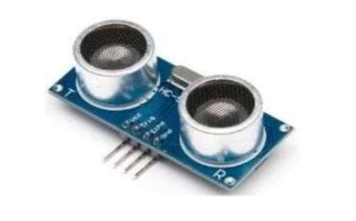
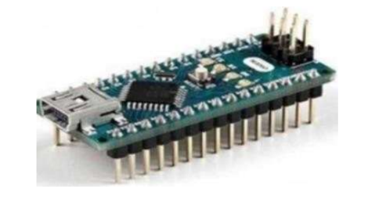
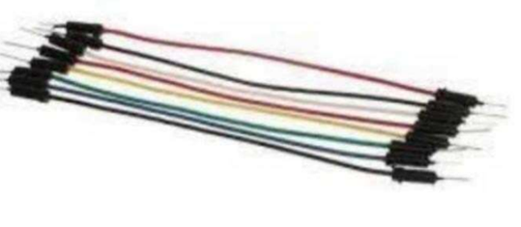
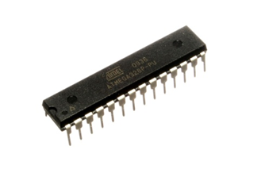
Figures Hardware and Software components
Arduino NANO
Ultrasonic Sensor
Microcontroller
Connecting wires

Slide 16
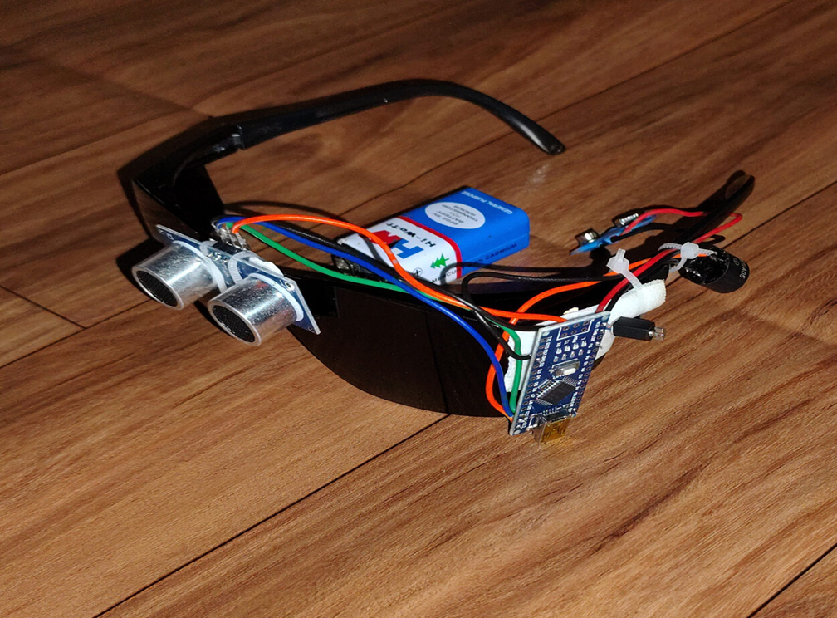
Output of the model

Slide 17
RESULTS AND DISCUSSIONS
The Ultrasonic Sensor–Based Spectacles were successfully designed, assembled, and tested to assist visually impaired individuals in obstacle detection. The system effectively uses an ultrasonic sensor, Arduino Nano, and buzzer to identify obstacles and provide real-time alerts through sound signals.
1. Experimental Results
The ultrasonic sensor accurately detected obstacles within a range of 2 cm to 400 cm.
The threshold distance was set at 100 cm; whenever an obstacle was detected within this range, the buzzer activated immediately.
The average response time of the system was less than 0.3 seconds, ensuring quick alert generation.
Tests were performed in various conditions – indoors, outdoors, and under different lighting-with minimal variation in detection accuracy.

Slide 18
CONCLUSION
The Ultrasonic Sensor–Based Spectacles were successfully designed and implemented to assist visually impaired individuals in detecting obstacles and improving their mobility. The system effectively integrates an ultrasonic sensor, Arduino Nano, and buzzer to provide real-time obstacle detection and audio feedback to the user.
The experimental results confirm that the device accurately measures distances and alerts users promptly when obstacles are within a predefined range. The compact design, low cost, and ease of use make it a practical and efficient assistive tool for daily navigation.
This project demonstrates how simple embedded systems can be applied to solve real-world problems and enhance the quality of life. It serves as a step toward technological inclusion by providing affordable support to visually challenged individuals.

Slide 19
REFERENCES
HC-SR04 Ultrasonic Sensor Datasheet, “HC-SR04 2cm–400cm Ultrasonic Sensor Module,” Electronic Wings.
S. Singh and P. Sharma, “Obstacle Detection System for Visually Impaired Using Ultrasonic Sensor and Arduino,” International Journal of Engineering Research & Technology (IJERT), vol. 7, no. 4, pp. 1–5, 2018.
A. Kumar, R. Sharma, and V. Gupta, “Wearable Assistive Device for Blind People Using Ultrasonic Sensors,” International Journal of Advanced Research in Electrical, Electronics and Instrumentation Engineering, vol. 7, no. 3, pp. 1256–1262, 2018.
H. M. Fadel, “Microcontroller-Based Navigation Aid for Visually Impaired People,” Journal of Sensors, 2019.A. Abdulkareem, “System for Visually Disabled through Wearables Utilizing Arduino and Ultrasound Equipment,” Journal of Engineering Science and Technology, vol. 10, no. 4, pp. 1–15, 2024.
S. C. Sethuraman, G. R.Tadkapally, S. P. Mohanty, G. Galada, and A. Subramanian, “Magic Eye: An Intelligent Wearable Towards Independent Living of Visually Impaired,”arXiv preprint arXiv:2303.13863, 2023.

Slide 20


